Slide 1
Navigation
Three types of orientation are used by animals in navigation
  Piloting (landmarks)
  Compass orientation
  True navigation

Slide 2
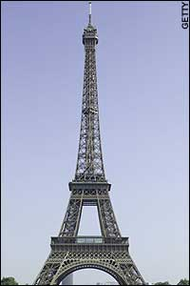
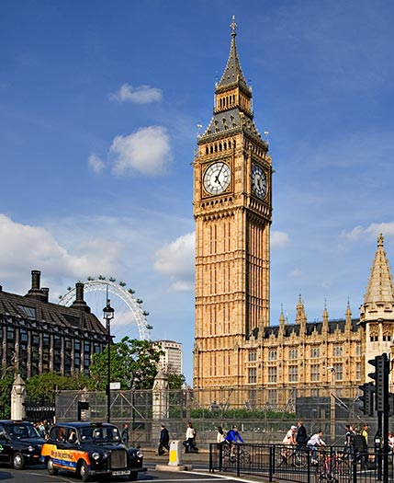
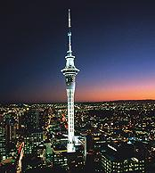
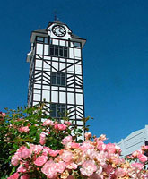
Piloting
Use of visual clues or landmarks
  Useful over short distances

Slide 3
Visual clues
Many animals learn their surroundings and use them to find their way home.
Tinbergen showed that digger wasps use visual clues to find the burrow which they stock with food and lay eggs in

Slide 4
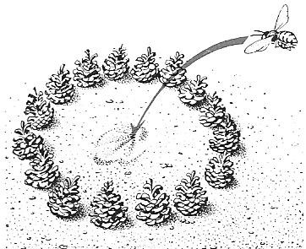
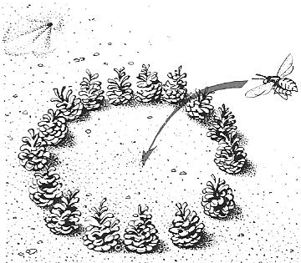
Tinbergen’s experiment
He placed a ring of cones around a burrow used by a wasp
He then moved the ring
He noted that the returning wasp went to the centre of the ring even though the burrow was visible

Slide 5
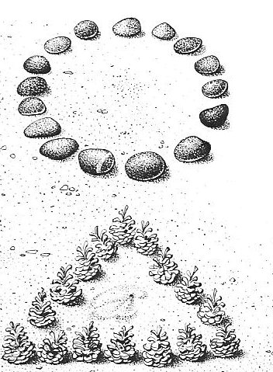
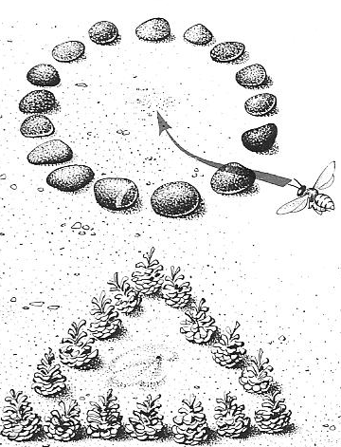
Tinbergen then placed a ring of stones near the burrow entrance
When the wasp returned it headed for the centre of the stones, showing it was the pattern that mattered most to the wasp

Slide 6
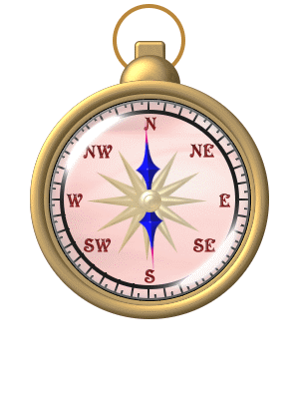
Compass Orientation
Animals may be able to detect a compass direction and travel along it in a straight line until they reach a destination.
This can be done using Earth’s magnetic field lines, chemical clues (smell) or sounds
The sun or stars may be used, but over long distances the rotation of the Earth must be taken into account.

Slide 7

True navigation
True navigation means an animal put in an unknown position “knows” where it is and can move straight toward home.
To do this it requires:
  a map sense (awareness of its latitude and longitude)
  An internal clock that allows it to compensate for the rotation of Earth

Slide 8
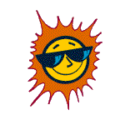
Solar Navigation
Many animals use the sun to navigate. This requires the use of a biological clock.
Many insects can detect the polarisation of light. This allows them to tell the position of the sun on cloudy days.

Slide 9
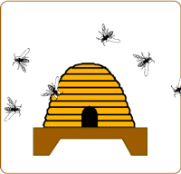
Honeybees
When Worker bees find more food than they can collect themselves they return to the hive and recruit more bees to return to the food source.
They not only navigate to and from the food themselves, but can convey information to other bees about the type of food and its direction and distance from the hive.

Slide 10
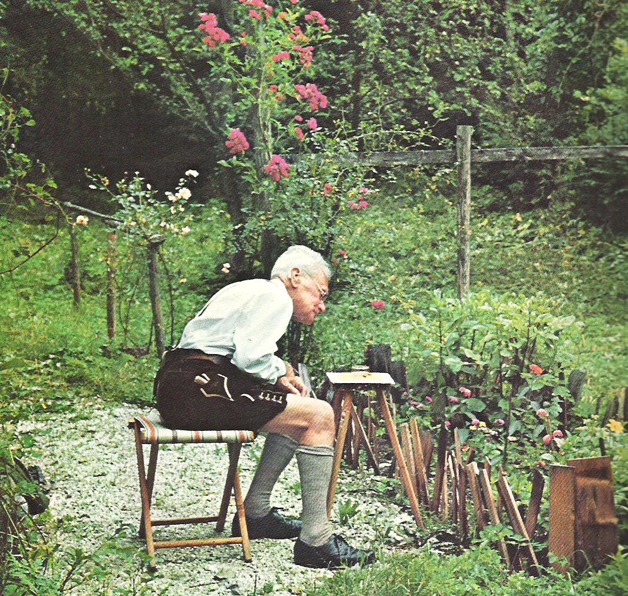
Karl von Frisch
Karl von Frisch worked out how bees communicate.
A returning bee “dances” on a vertical comb.
If food is near it does a “round dance”.

Slide 11
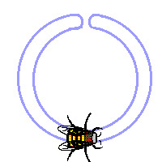
Round dance
This is used when the source of food (nectar or pollen) is less than 100 metres away. Food is passed from the dancing bee to those watching and following, giving information about it’s taste and smell. The round dance does not appear to tell the bees in which direction to go to the food source just that the food "is close to the hive and tastes and smells like this".

Slide 12
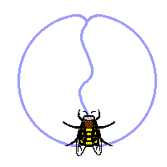
The Waggle dance
For food supplies more than 100 metres away the waggle dance is used. The bee uses gravity (vertically upwards) as the position of the sun and if, say the food is 30° to the left of the sun then the bee will dance 30° to the left of the vertical on the frame.
Whilst the bee is indicating direction she waggles her body from side to side to indicate distance to the food source. The more waggles the closer the food source is to the hive.
The waggle dance gives both direction and distance to the food source and by tasting the food the bee knows what to look for

Slide 13
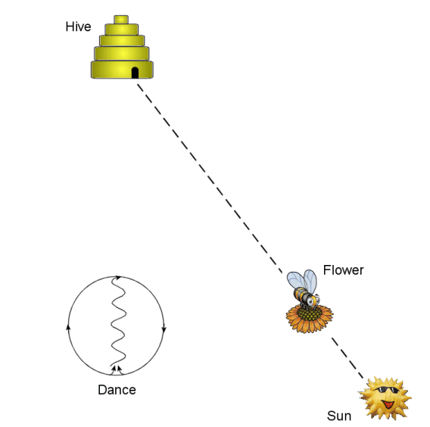
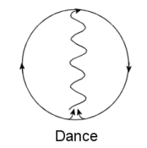
Food in direction of sun

Slide 14
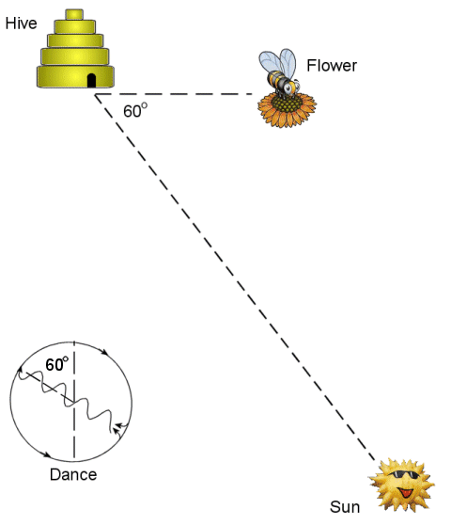
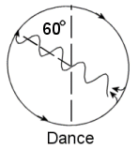
Food 60° to left of sun

Slide 15
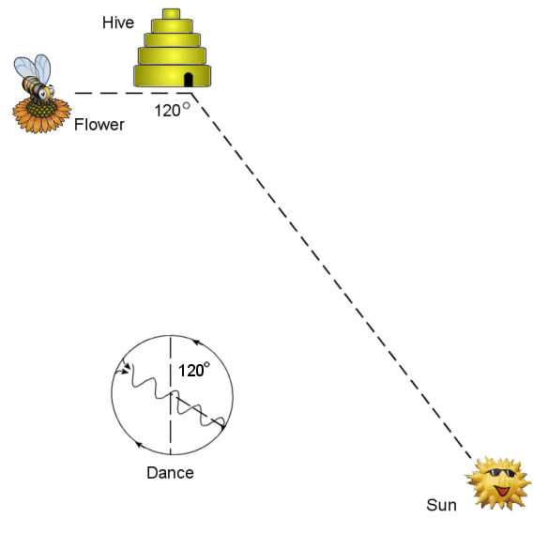
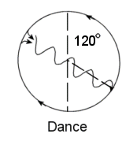
Food 120° to right of sun

Slide 16
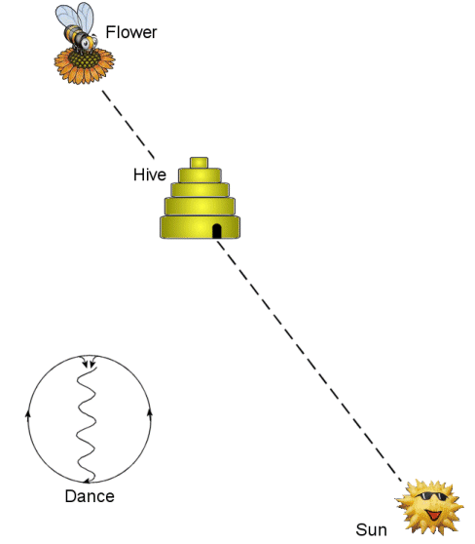
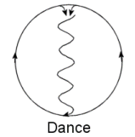
Food in opposite direction from sun

Slide 17
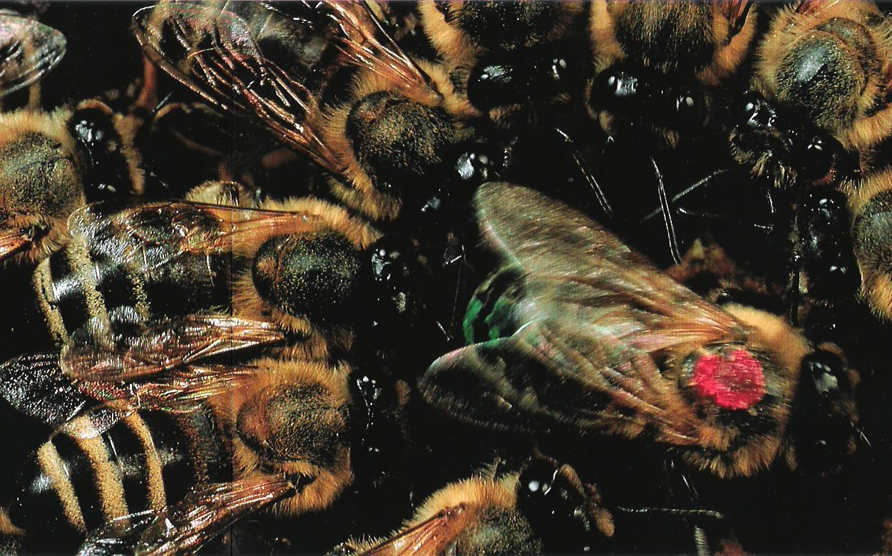

Slide 18
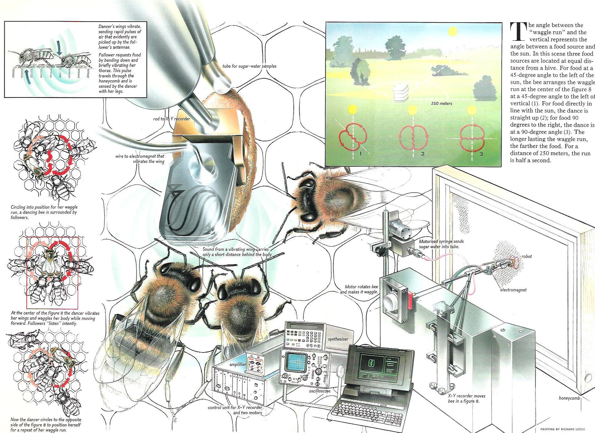

Slide 19
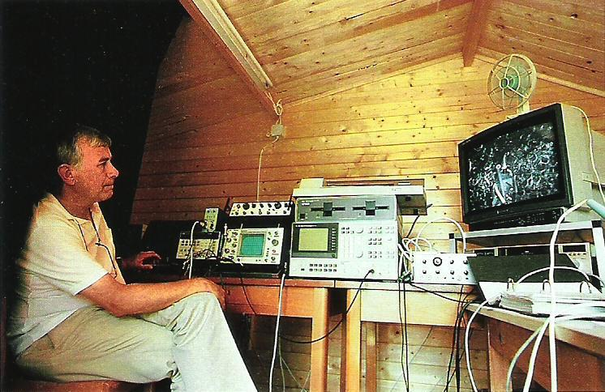

Slide 20
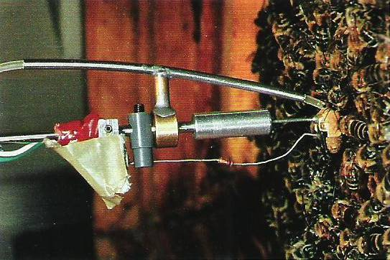

Slide 21
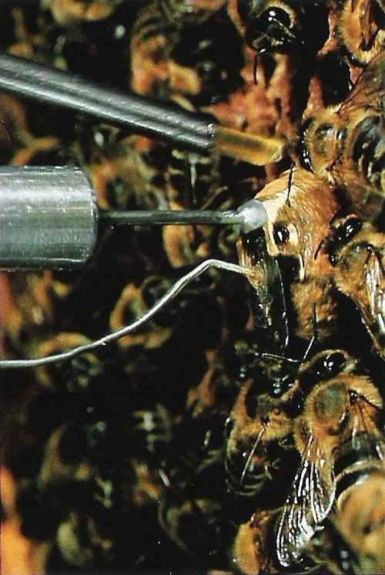

Slide 22
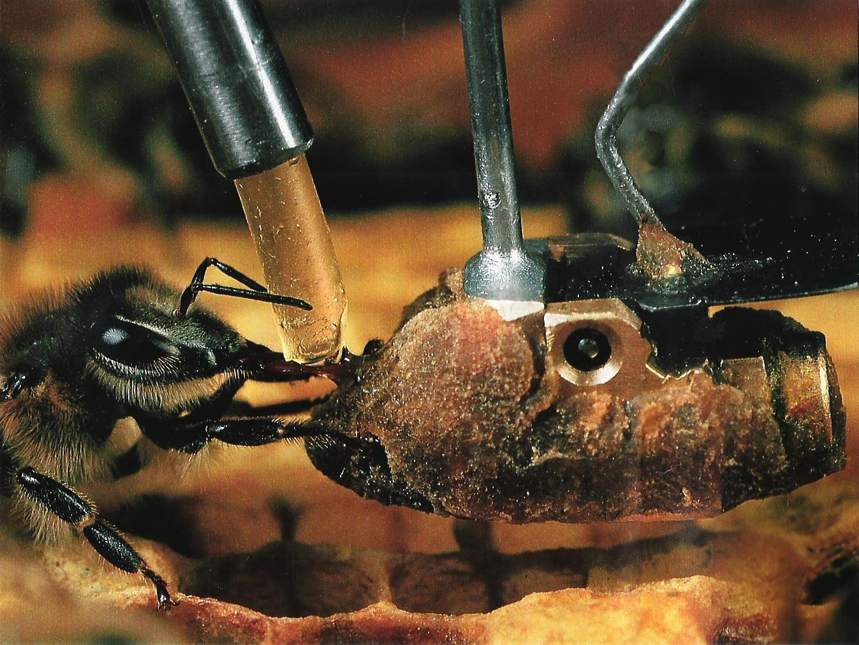

Slide 23
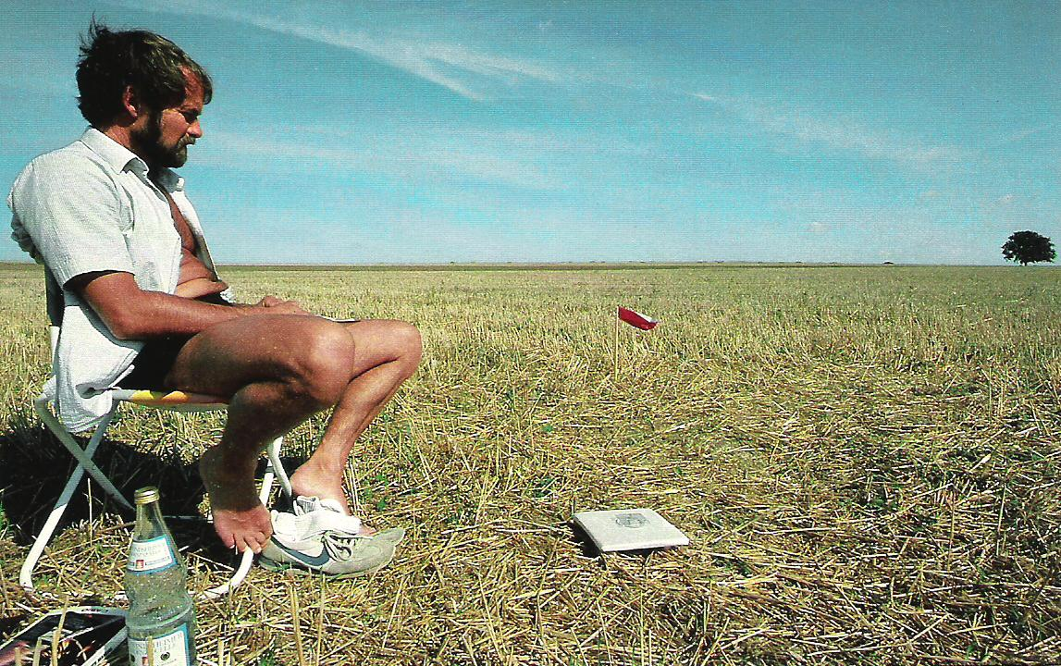

Slide 24
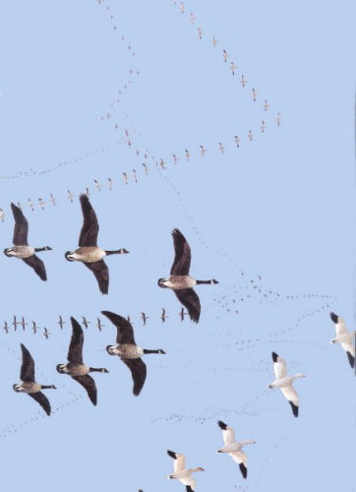
Bird navigation
Many migratory birds such as ducks and geese fly mainly in daytime and use a sun compass
Their biological clock allows them to compensate for the sun’s changing direction

Slide 25
Bird experiments
Experiments have been done where a bird has had its internal clock retarded 6 hours by placing it in artificial light/dark cycles.
When released, these birds then fly at the wrong angle for the real time of day

Slide 26
Magnetic fields
Many animals use the magnetic field lines of the Earth to navigate
Birds, whales, dolphins and even bacteria are known to have miniature magnetic compasses.
homing pigeons have a magnetic compass.
  If a magnet that deflects the normal magnetic field is attached to the head of a homing pigeon, the birds can be made to fly off- course by the same degree of deflection. However, if it is a clear day the birds use their other navigational skills (such as sun compasses and visual landmarks), and most manage to get home.

Slide 27
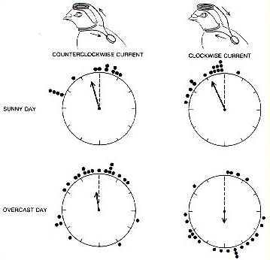

Slide 28
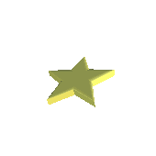
Star (stellar) navigation
Night-migrating birds use a star compass. This was shown by placing these birds in a planetarium, a dome-like theatre with stars projected onto its roof. The birds (in their cages) oriented to the artificial sky. Further experiments showed that the birds only oriented to the brightest northern stars, as these move the least during the night.

Slide 29
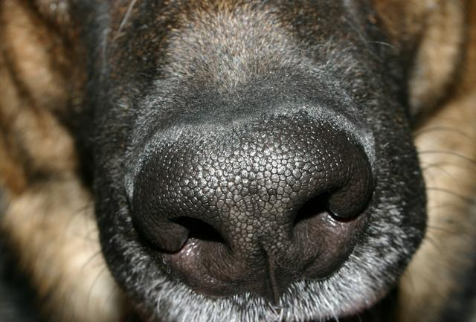

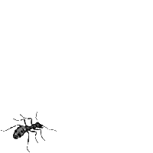
Chemical navigation
Dogs follow scents to find home, and ants leave chemical trails for other ants to follow. The amazing migrations of eels and salmon from the sea to certain rivers (where they emigrated from originally) are guided by the animals smelling ‘their’ rivers. This is a cocktail of chemicals in the freshwater streams that the migrating animals recognise.

Slide 30
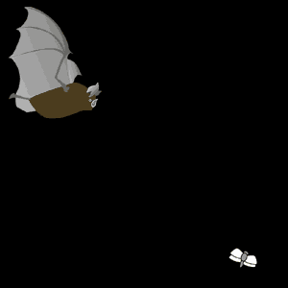
Sound used as sonar
Bats navigate by using high-pitched squeaks which bounce off objects in their path.

Slide 31
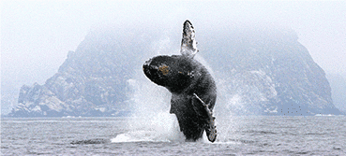
Sound used as sonar
Humpback whales migrate to the Antarctic and the Arctic oceans each summer, and back to the equatorial waters for breeding. They orient themselves by sonar, for they have excellent hearing and a vast range of clicks and booms — though how they use this to navigate is not yet understood.

Slide 32
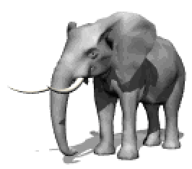
More sonar
Infrasound — sound with a frequency of less than 10 Hz — is called infrasound. We cannot hear it, but pigeons can hear down to 0.06 Hz. Infrasound travels long distances: pigeons may use natural sound such as surf crashing onto beaches as a navigational aid. We now know that elephants can hear infrasound and can communicate at 5-mile (8 km) distances with other members of their herd.

Slide 33
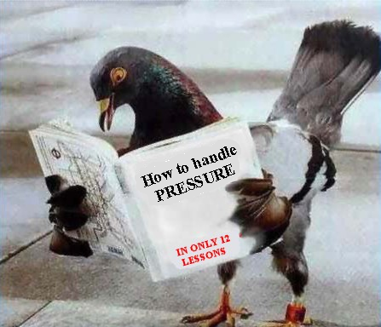
Ambient pressure
Pigeons are sensitive to atmospheric pressure changes equivalent to an altitude of 10 m. This sensitivity may give pigeons a fairly accurate altimeter.

Slide 34
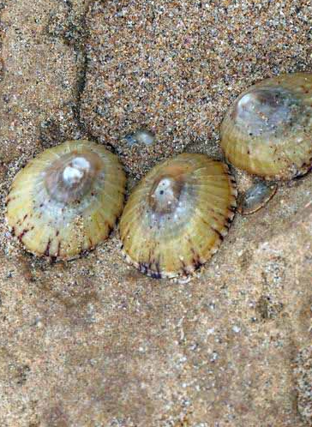
Conclusion
Many animals use more than one method to navigate, and many mechanisms for homing and migration are not yet understood. For example, the lowly limpet scratches a shallow hollow on a rocky surface in which its shell fits closely. It leaves the hollow to feed when the tide is in, yet manages to return home before the tide goes out.

